Slide 1

Identify significant co-occurring or mutually exclusive mutated driver genes across cancer types
Group: Dan Peng, Luchao Qi, Xi Wang
Notes:
Structured pretty much the same way as report, work on slides for your sections for report
Notes: We are graded on presentation Nice, clean slides, not too crowded Good visual aids No walls of text! Steer clear of too much technical jargon on slides - that can go in report

Slide 2
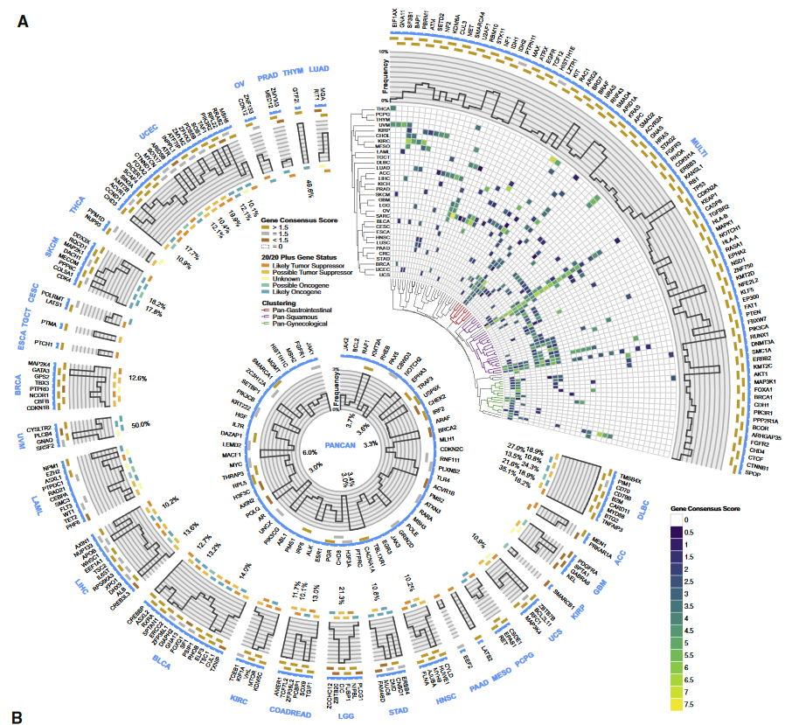
Background - Cancer Driver Gene Mutations
Genetic mutations that drive tumorigenesis (most notable TP35, PI3K)
Currently there are 299 identified cancer driver genes from previous publication
Use cohorts of MAF data from TCGA to study cancer driving mutations
Notes:
Dan
Good afternoon everyone, we are the driver gene mutation group. Our goal is to identify co-occuring or mutually exclusive driver genes
So what are driver genes

Slide 3
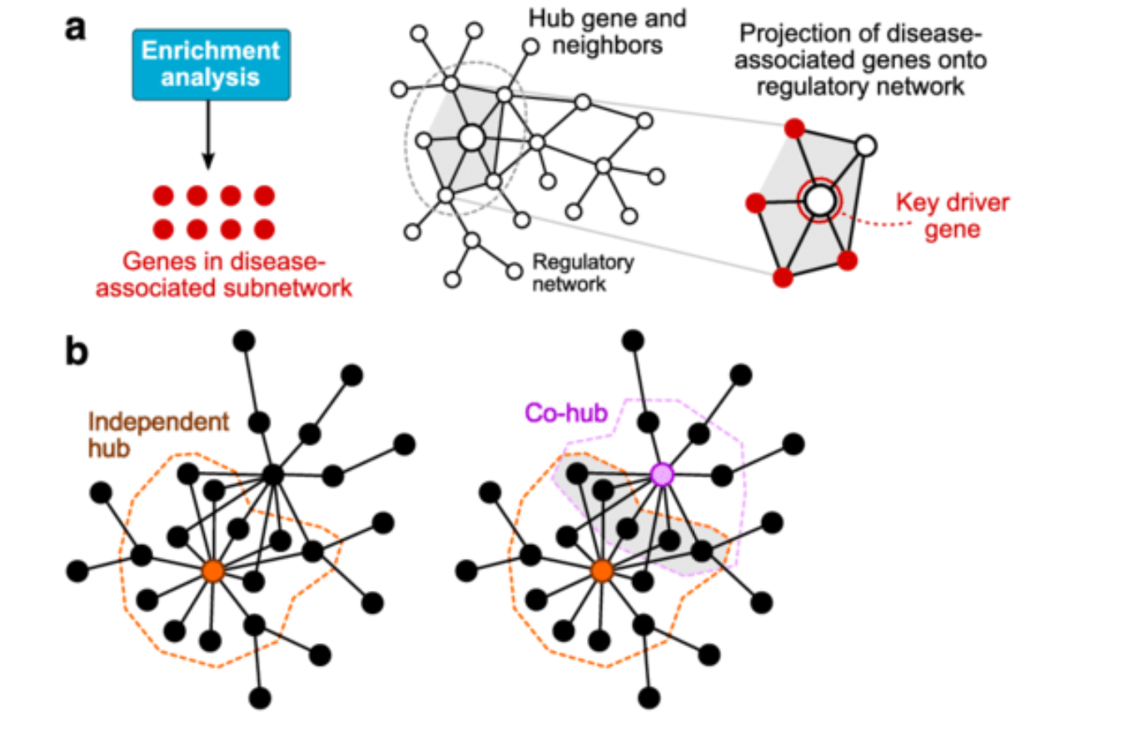
Project Significance
Identified driver gene pairs that are either co-occurring or mutually exclusive
A good way of studying cancer driving pathways
Mutually exclusive: only one of the gene is potentially needed to induce cancer
Co-occurrence: both genes might be needed to induce cancer
Identify key driver gene - hub
Provide a quick screening of driver gene interactions without laborious experiments
Schematic illustration of the concept of a key driver gene (a) and local hubs with overlapping neighborhoods (b)
Notes:
Coocurance and mutually exclusive sallows us to better study the pathwas involved in tumorgenesis
https://onlinelibrary.wiley.com/doi/pdf/10.1002/wsbm.1364
Figure: Mergeomics: Multidimensional data integration to identify pathogenic perturbations to biological systems

Slide 4
Specific Aims
Encode mutations from TCGA MAF data
Find co-occurring or mutually exclusive drive genes
Compare fisher’s exact test, chi-square test (traditional approach) and permutation test (our approach) for finding co-occurring driver genes
Use existing tools to identify mutually exclusive driver genes
Notes:
Talk about different cancer types

Slide 5
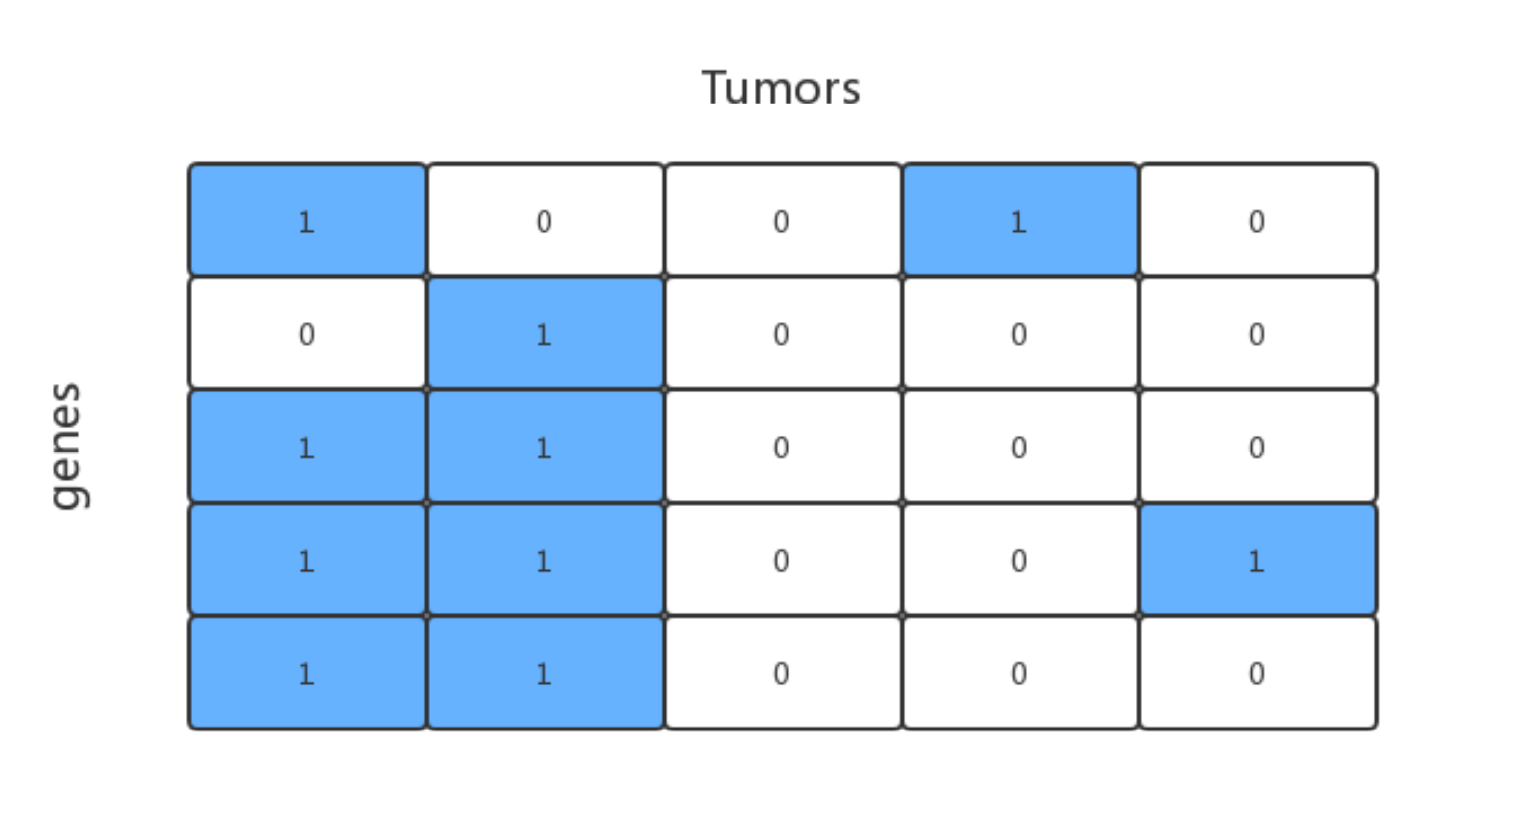
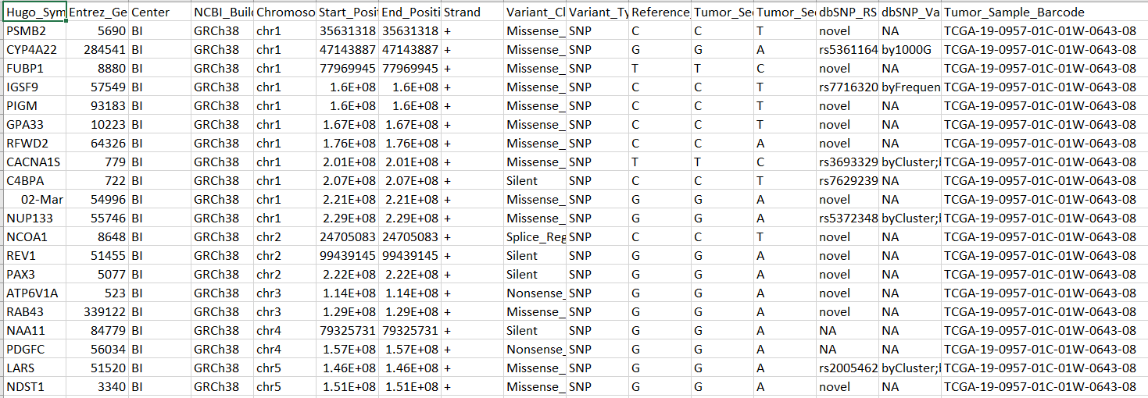
Data Encoding
All mutations are encoded as 1
Notes:
MP Slide
L

Slide 6
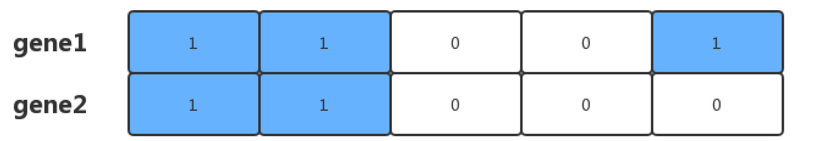

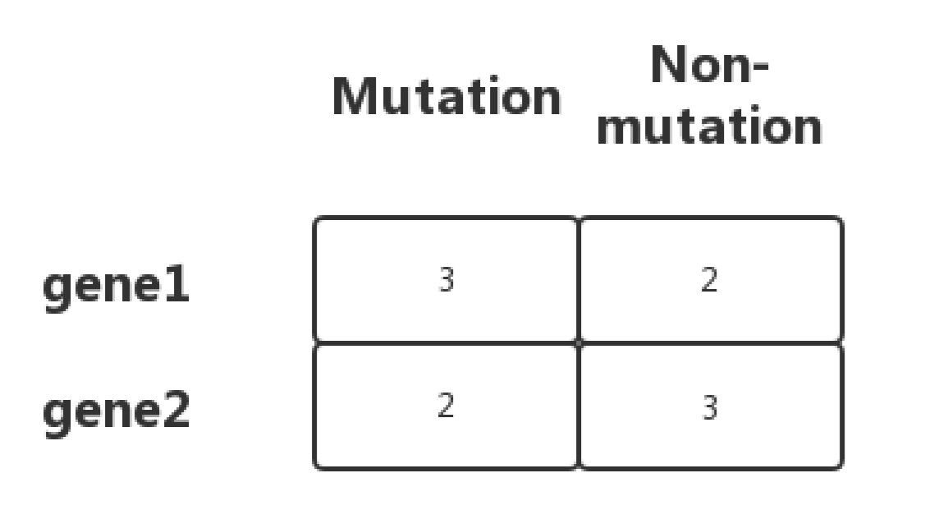
Approach 1, Fisher’s exact test
H0: P(mutation | gene 1) = P(mutation | gene 2)

Slide 7
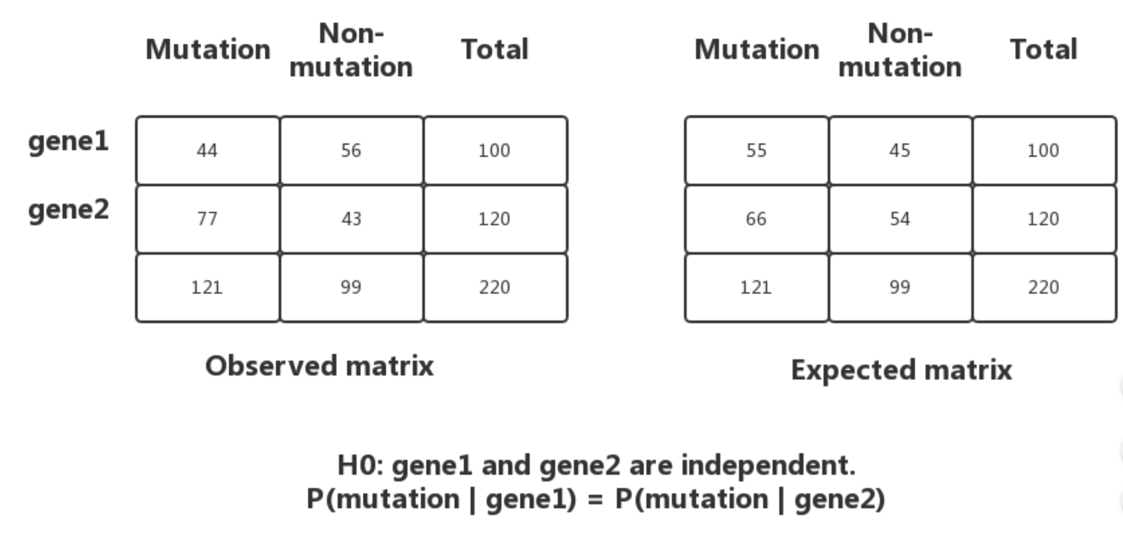
Approach 2, Chi-Square Test

Slide 8
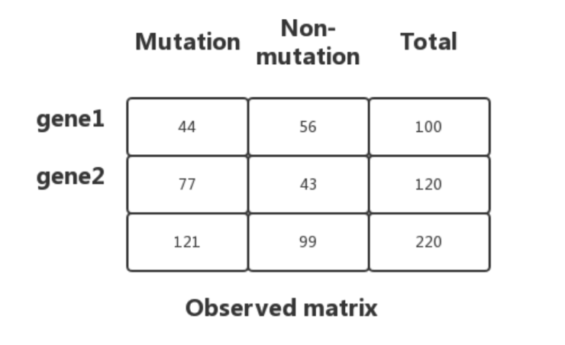
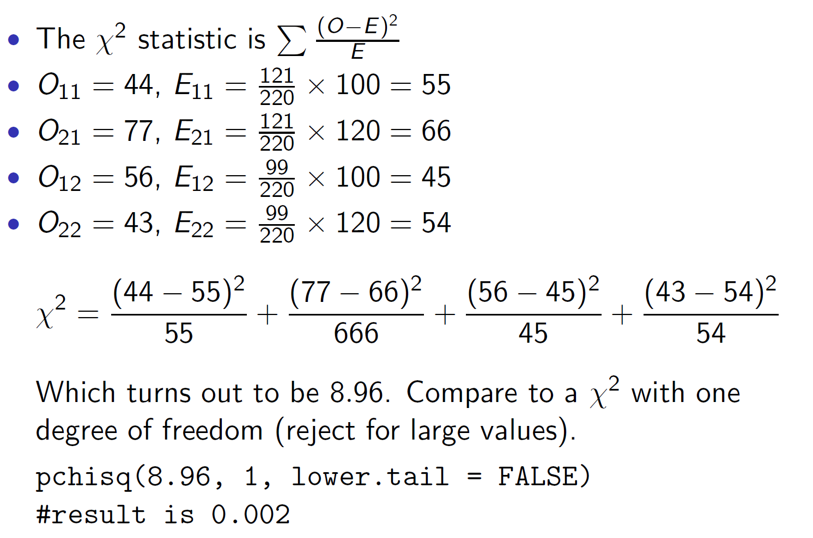
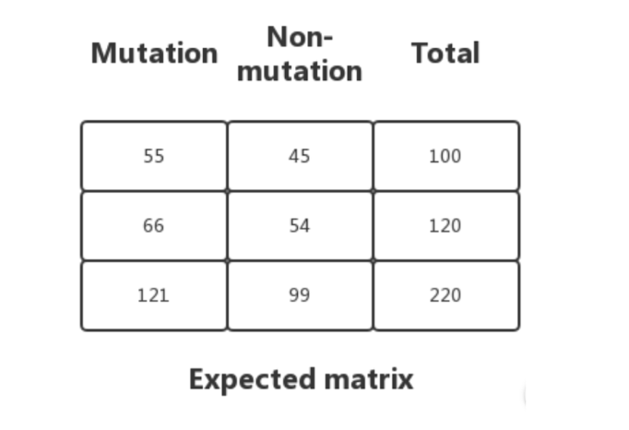
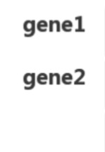

Slide 9
Approach 3, Permutation Test
1
1
...
0
0
1
...
1
1
0
...
1
1
0
...
1
...
X 500
0
1
...
0
1
0
...
1
 | Perm 1 | ... | Perm 500
# of Co-occurrences | 5 | ... | 40
Notes:
Dan - show histo of gene pairs to depict distribution

Slide 10
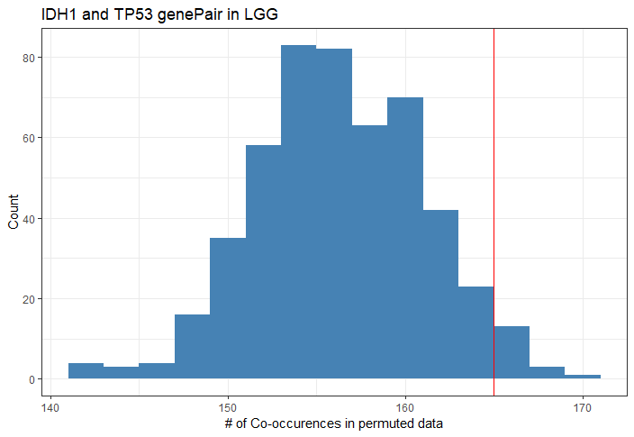
Approach 3, Permutation
Pro:
Less false positive than Chi-square or Fisher's test
Con:
Extremely time consuming and resource intensive
Notes:
Dan - show histo of gene pairs to depict distribution

Slide 11
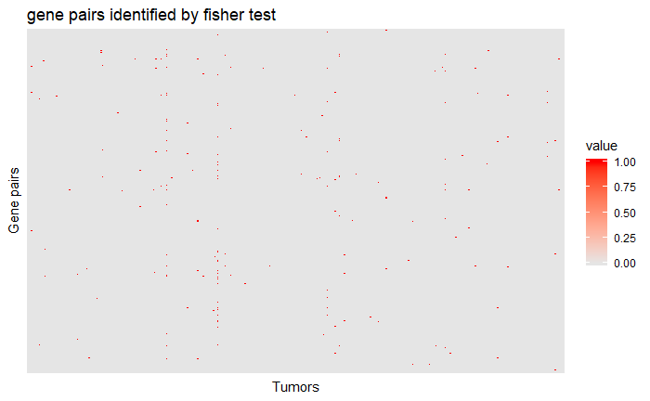

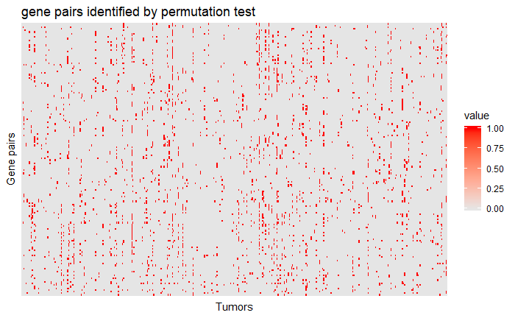
Fisher
Chi-square
Fisher(4000+ gene pairs)/Chisq(1000+ gene pairs): High speed - time saving
Permutation: Less False Positive- extremely slow
Notes:
Encode the data such that red represent co-occuring and grey indicate mutually exclusive?
Have to explain that the number of gene pairs is very different between Fischer test and Permutation test. Each block represent something very different

Slide 12
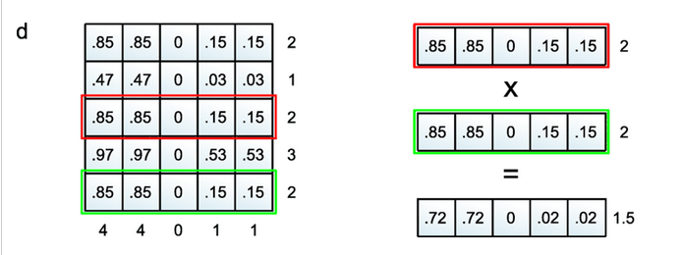
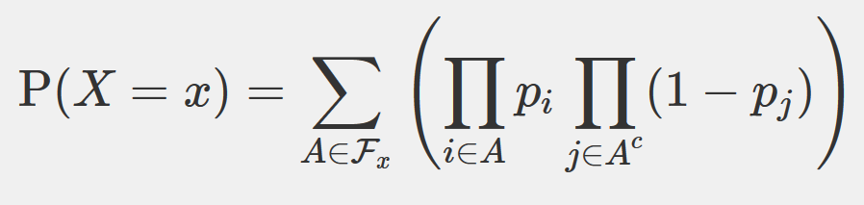
DISCOVER TOOL - Mutually Exclusive
A novel tool made by a group in the Netherlands Cancer Institute
Find gene alteration probability for every tumor based on a constraint optimization problem
Analytical test based on Poisson-Binomial distribution

Slide 13
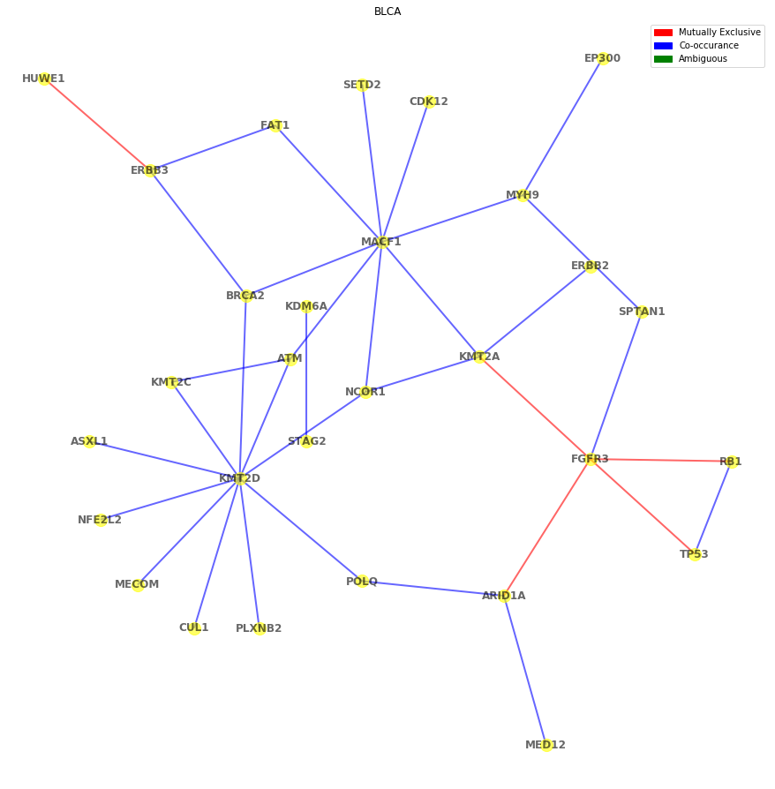
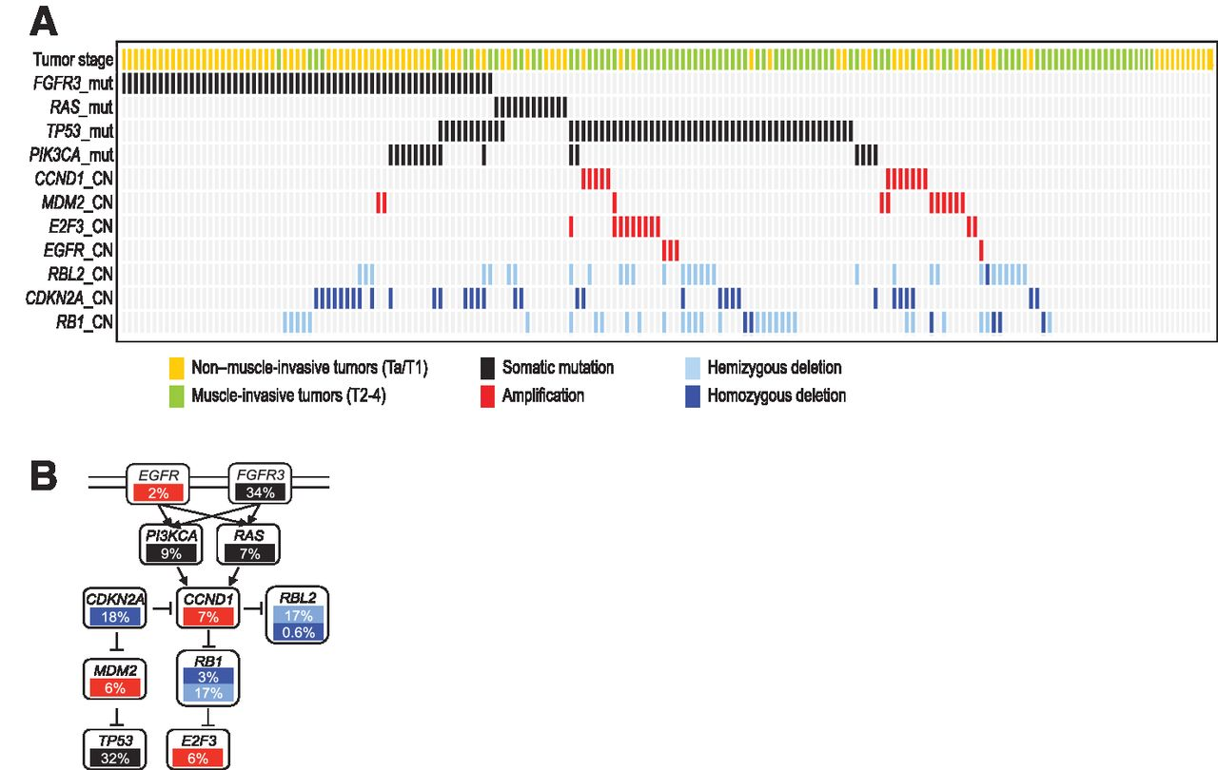
BLCA
“mutual exclusivity of FGFR3 and TP53 mutations is interpretable if FGFR3 is mutated first”
A Modeling Approach to Explain Mutually Exclusive and Co-Occurring Genetic Alterations in Bladder Tumorigenesis Elisabeth Remy, Sandra Rebouissou, Claudine Chaouiya, Andrei Zinovyev, François Radvanyi and Laurence Calzone
Notes:
At the end, we decide to use the permutation test for testing co-occurnace and the Discover tool to test mutually exclusive.
To have a sanity test, we compared our results with previous literature studying BLCA co-occurance/mutually exclusive driver genes.
On the right, there is a network of co-occuring and mutually exclusive driver genes. Red means mutually exclusive and blue means co-occuring
On the left is the results from literature. As you can see, there are some overlaps between the hubs identified through our method and the data.

Slide 14
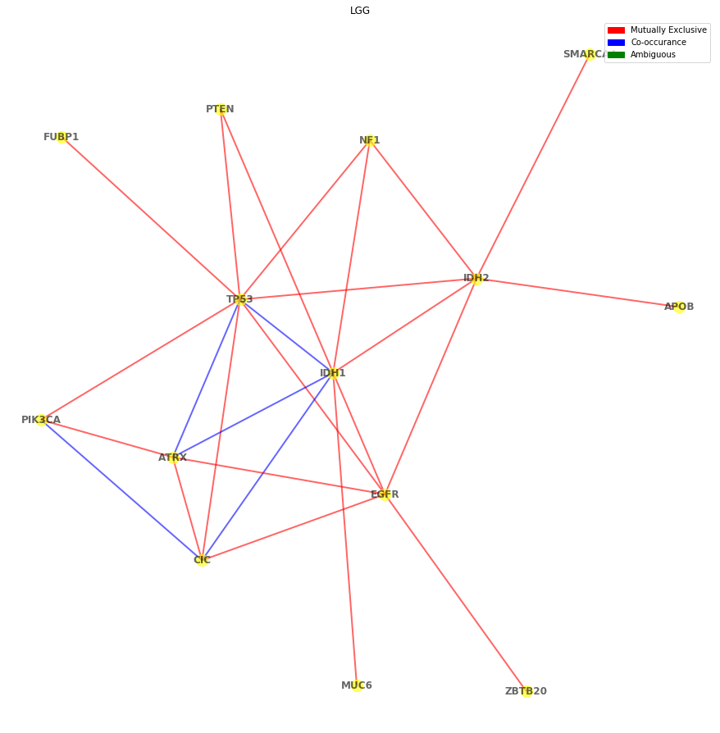
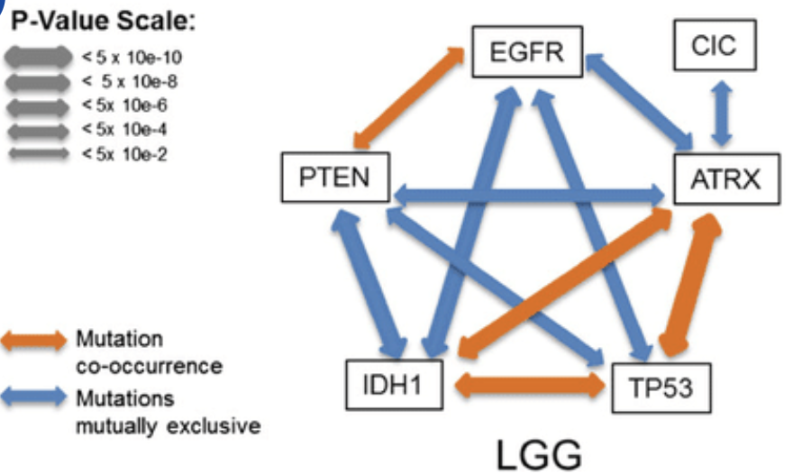
LGG
A global assessment of cancer genomicalterations in epigenetic mechanismsMuhammad A Shah1†, Emily L Denton1,4†, Cheryl H Arrowsmith1,2, Mathieu Lupien2and Matthieu Schapira1,3*
Notes:
Another cancer type that we used to test is glioma, we first start from lower grade.
As you can see from the comparison, all the genes identified from the publication are also discovered with our methods. With very similar co-occruance and exclusive relationships
Additionally we found other important gene hubs such as IDH2 which is a very important drive gene in glioma formation

Slide 15
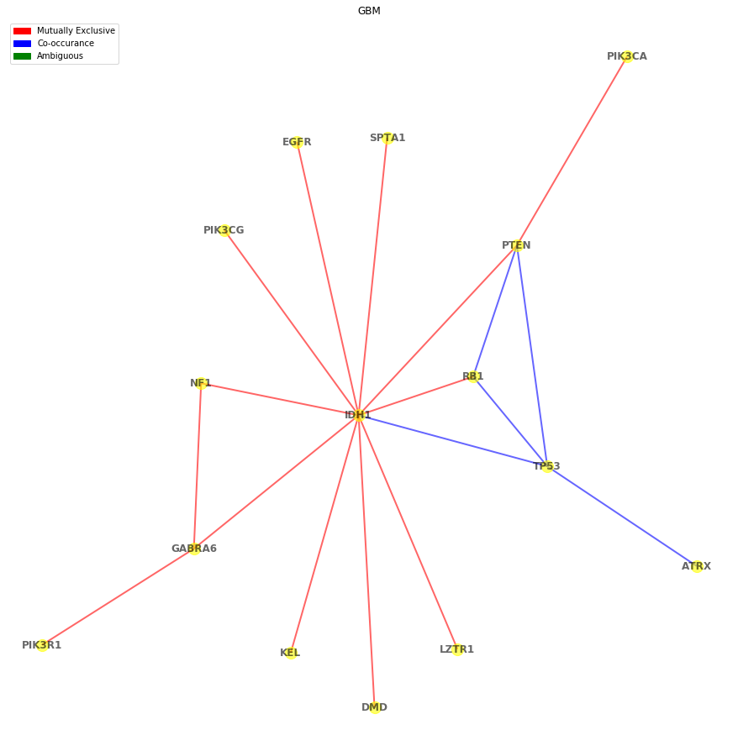
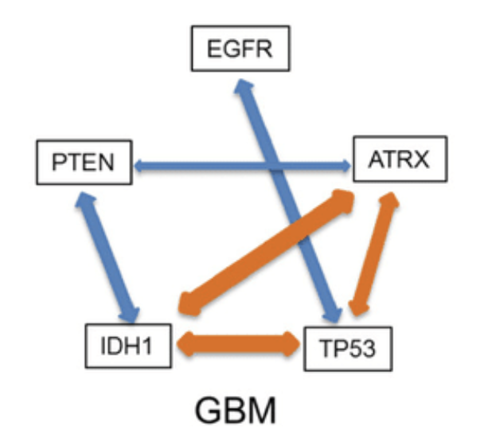
GBM
A global assessment of cancer genomicalterations in epigenetic mechanismsMuhammad A Shah1†, Emily L Denton1,4†, Cheryl H Arrowsmith1,2, Mathieu Lupien2and Matthieu Schapira1,3*
Notes:
Some of the edges are disconnected and our method caught that

Slide 16
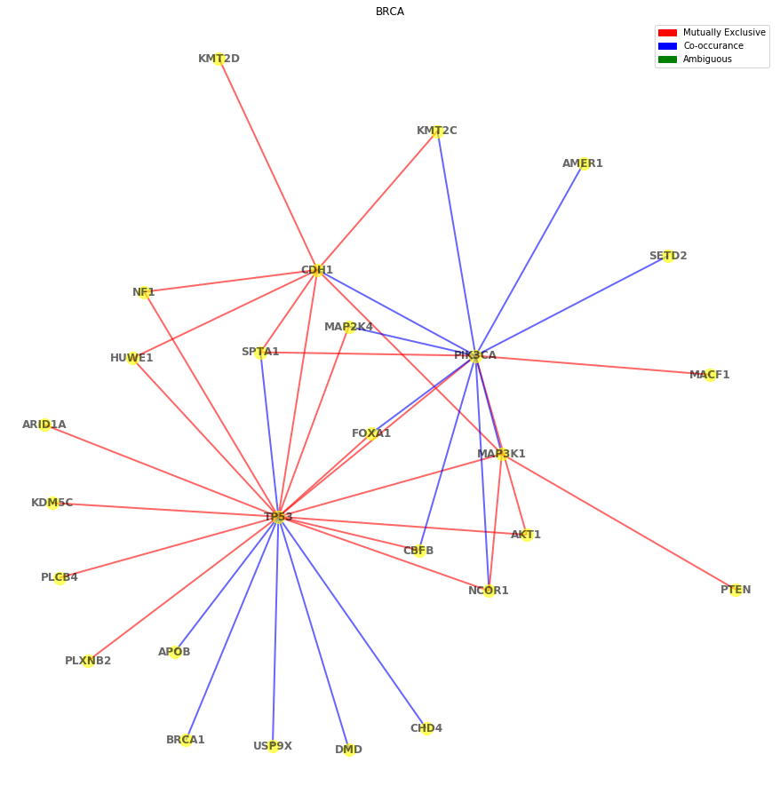
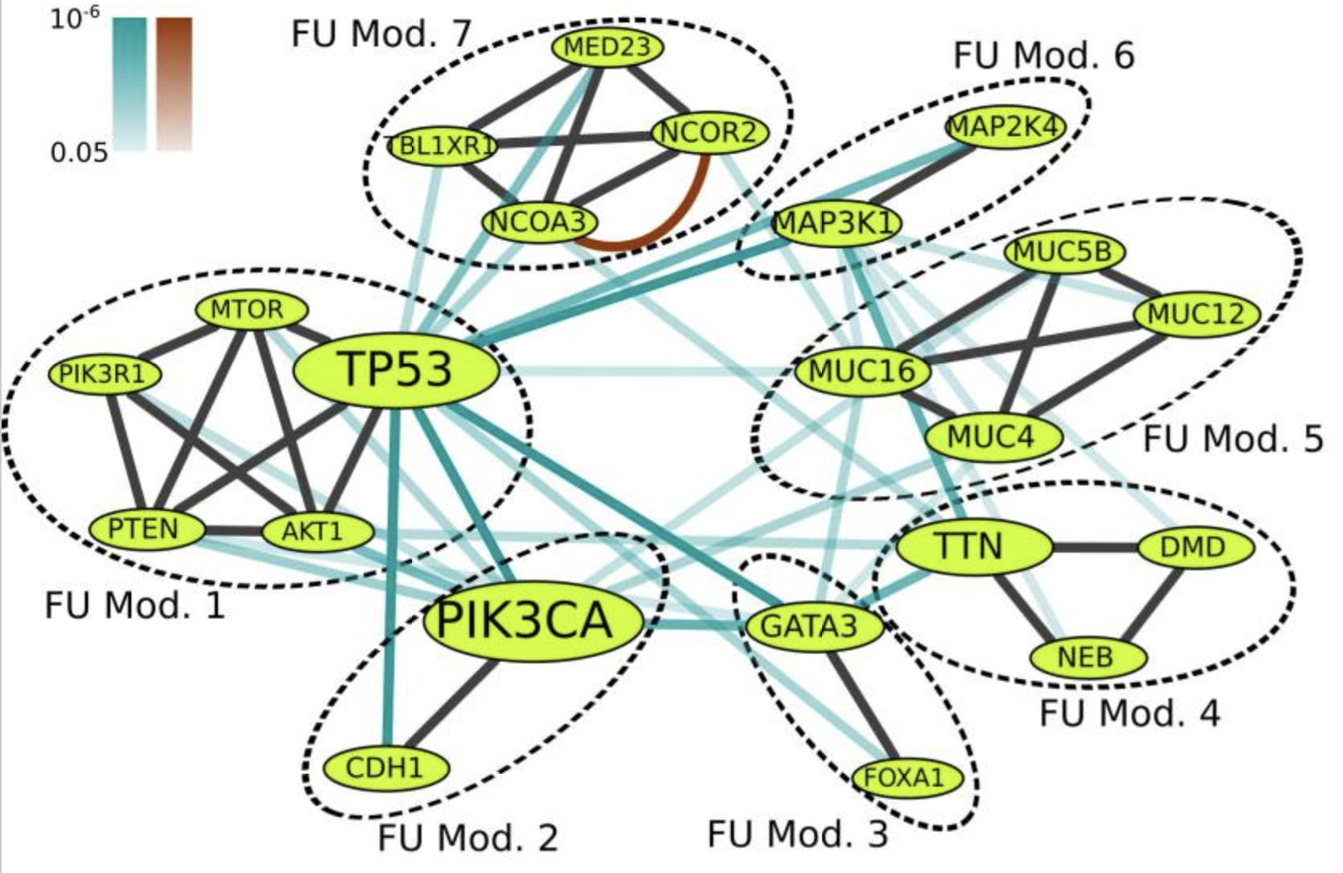
BRCA
Functional modules with mutual exclusivity between modules
Mod. 2
Mod. 6
Mod. 2
Mod. 3
Mod. 6
Mod. 1
Mod. 1
Mod. 1
BeWith: A Between-Within method to discover relationships between cancer modules via integrated analysis of mutual exclusivity, co-occurrence and functional interactions
Mod. 4
Notes:
Similarly, we found a literature specifically studying BRCA and UCEC. The paper studies mutual exclusivity based on functional modules and co-occurrence modules.
For this functional module study, all modules are identified in our network with one significant gene

Slide 17
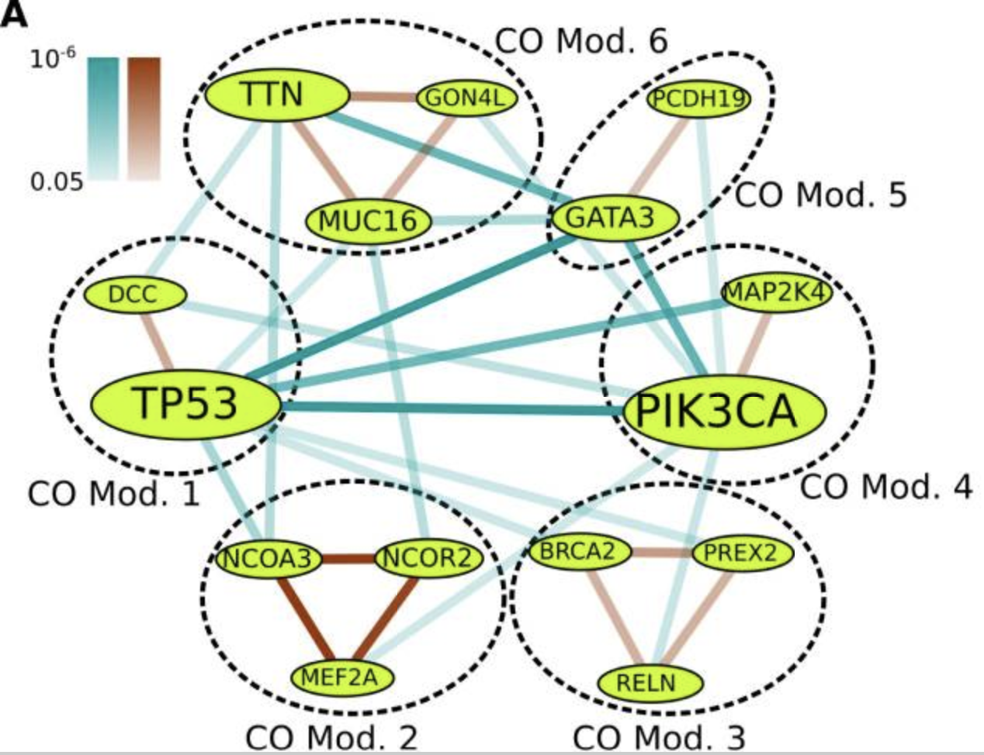
BRCA
Co-occurrence modules that are mutually exclusive with each other
Mod. 4
Mod. 4
Mod. 1
BeWith: A Between-Within method to discover relationships between cancer modules via integrated analysis of mutual exclusivity, co-occurrence and functional interactions
Notes:
However, the paper’s co-occurrence modules network is very different from its functional modules. As a result, only significant genes like TP53, MAP2K4, PIK3CA are identified in our network

Slide 18
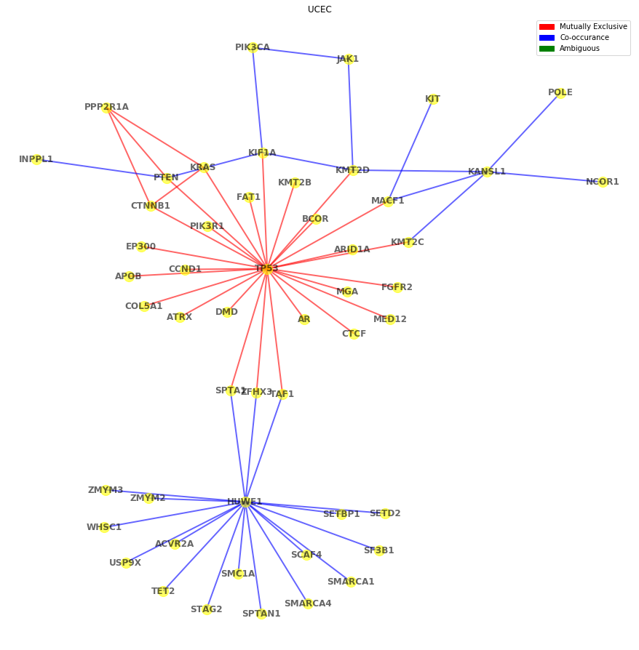
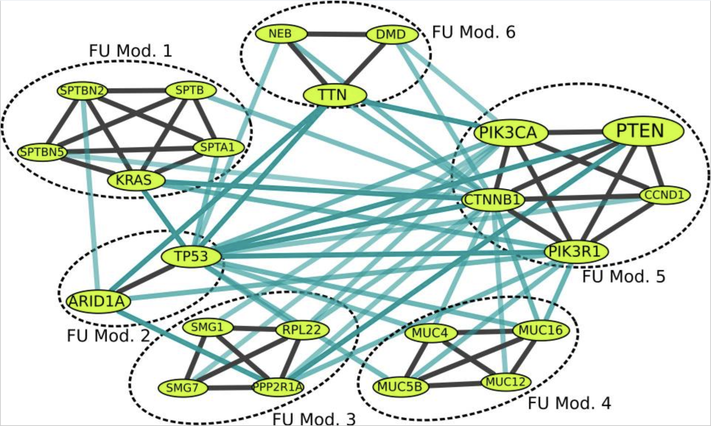
UCEC
Functional modules with mutual exclusivity between modules
Mod. 5
Mod. 3
Mod. 5
Mod. 5
Mod. 2
Mod. 5
Mod. 1
BeWith: A Between-Within method to discover relationships between cancer modules via integrated analysis of mutual exclusivity, co-occurrence and functional interactions
Notes:
Now let’s look at the UCEC’s functional modules from the paper. We also found the our network overlapped mostly with the paper’s, with the exception of Mod.4
Additionally, although the paper does not include a co-occurrence network result, our network found an interesting co-hub around HUWE1 and TP53

Slide 19
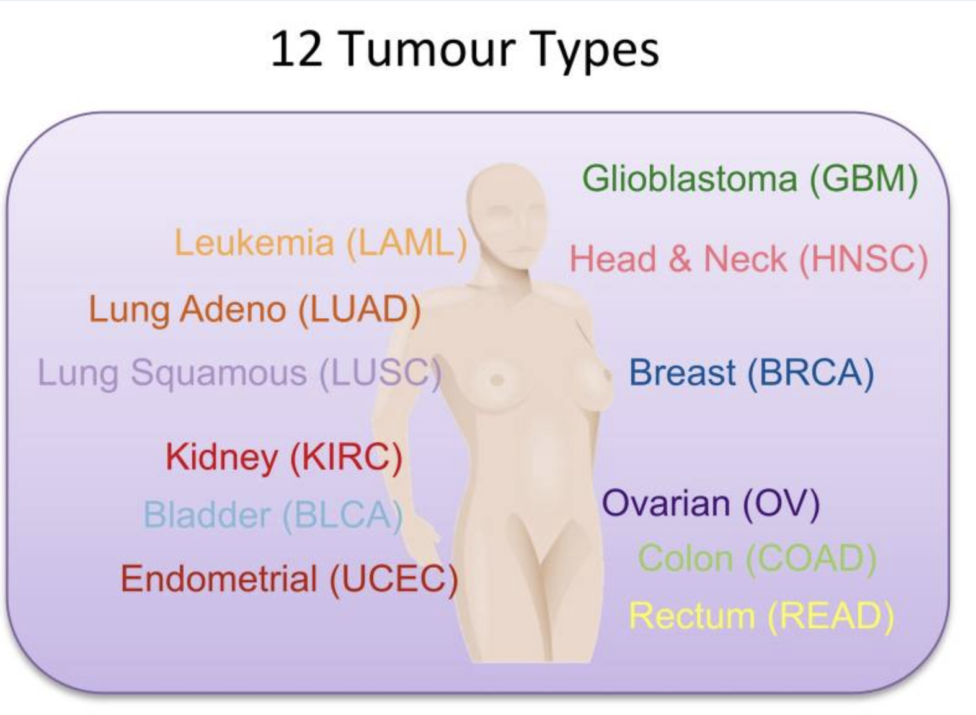
Tested Cancer Types
And thresholds
BLCA ✓
BRCA ✓
CESC: ME: 0
GBM ✓
KIRC ✓: ME: 0, Co: 0
LGG
LIHC: ME: 0, Co: 0
LUAD ✓
LUSC ✓
PAAD
SKCM
STAD
UCEC ✓
*ME: Mutually Exclusive
(qval<=0.08)
**Co: Co-occurrence
(pval < 0.05) AND (co-Occurance >= co_cut)
Notes:
Lastly, we take a look at cross-cancer types testings. The DISCOVER paper tested on 12 Tumour Types, and we tested on 13 Tumour types, with 7 cancer types overlapping.
Therefore it would be partially meaningful to compare the network results.

Slide 20
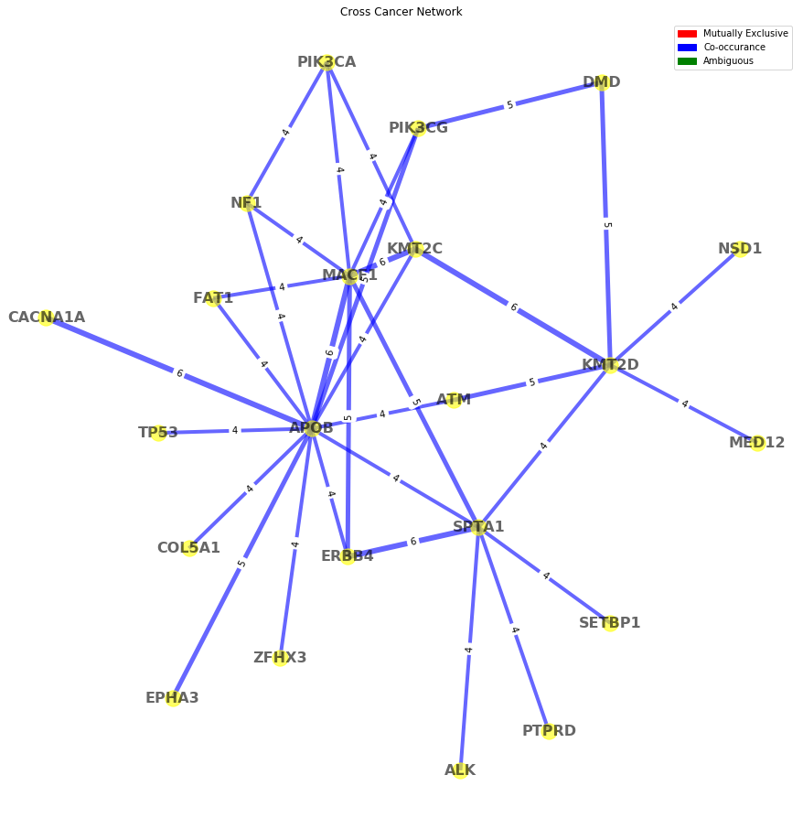
Network Cross 13 Cancer Type
Repetitive Gene Pair Testing
“No evidence for widespread co-occurrence”
At Max FDR of 1% - N/A
At 3%:
TP53 & MYC-amplified
MYC-amplified ->EGFR and/or ERBB4
“Mutually exclusive alterations target core cancer pathways”
>=4 repetition
Canisius, Sander et al. “A novel independence test for somatic alterations in cancer shows that biology drives mutual exclusivity but chance explains most co-occurrence.” Genome biology vol. 17,1 261. 16 Dec. 2016, doi:10.1186/s13059-016-1114-x
Notes:
Regarding the conclusion on Co-occurrence, the paper believe that there is no evidence for widespread co-occurrence, and even with loosened threshold, the paper only stated one potential gene-pair: TP53 & MYC-amplified.
Some paper states that MYC-amplified would usually occur together with EGFR and ERBB4, and we can see the relationship partially revealed by the hub APOB.
In this aggregated network, we label the edge with number of repetitive occurrence across cancer types, In addition, we have identified other potential hubs colored in pink, such as KMT2D & MACF1

Slide 21
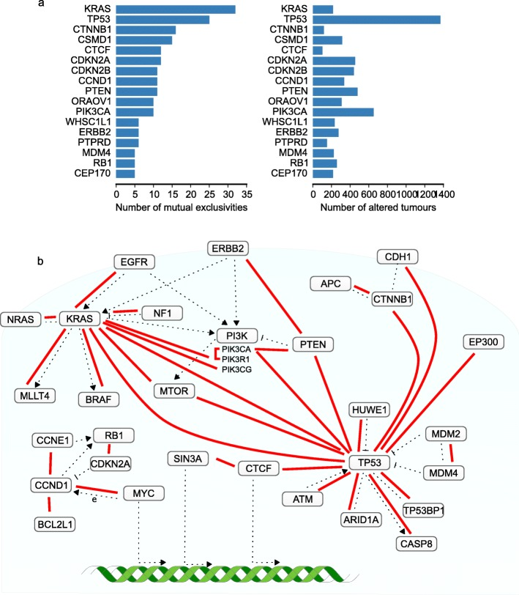
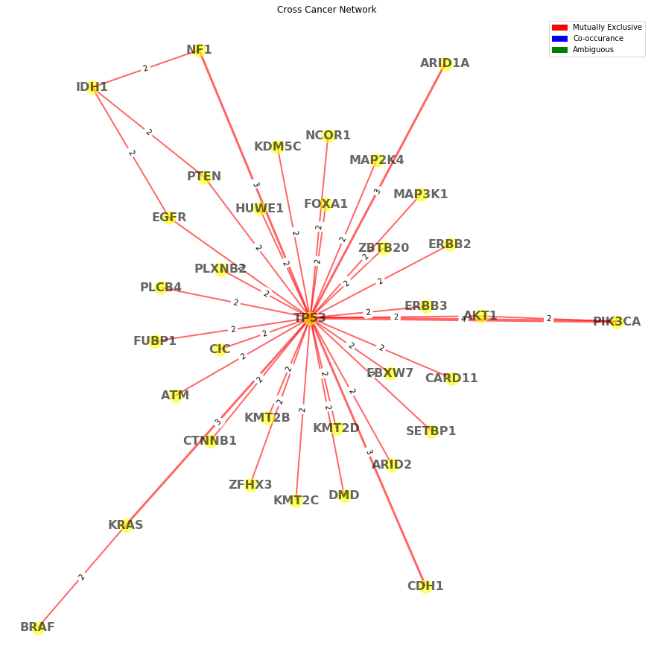
>=2 repetition
Notes:
Our Mutually Exclusive Network is drawn in a similar manner. We have a great percent of overlapping with the paper’s network.
Note that our 13 cancer types and DISCOVER paper’s 12 cancer types only have 7 cancer overlapping. Achieving such similarity should be considered a solid result.

Slide 22
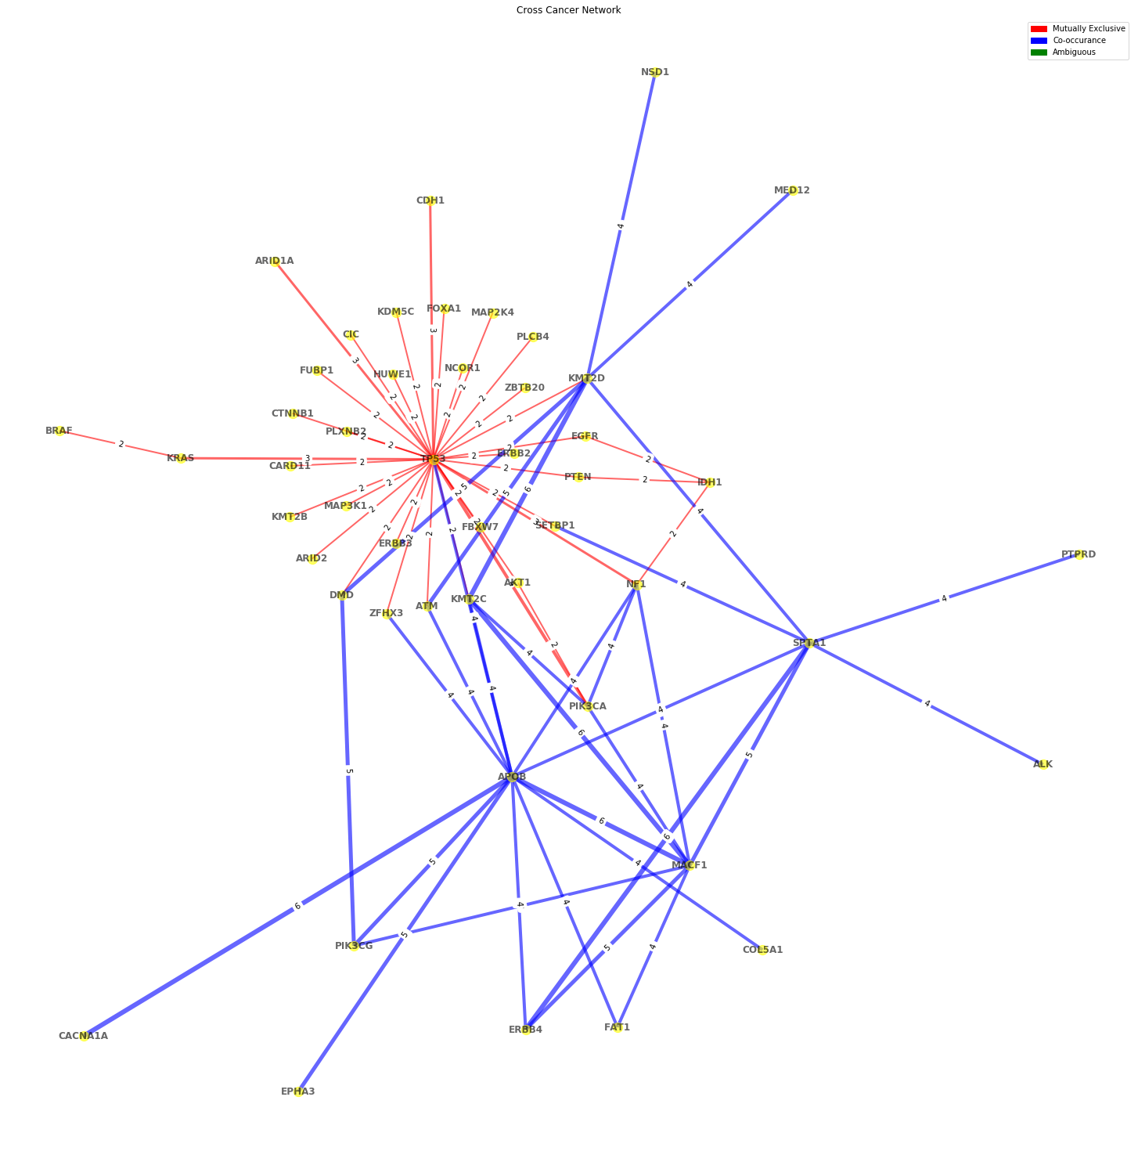
Half of the Mutually Exclusive gene paired with TP53 have some repetitive co-occurrences.
Basically among half of the mutually exclusive edges with end node TP53, the other end node will share a blue edge.
Unidentified hubs like APOB, SPTA1, KMT2D and MACF1.
Notes:
Lastly, we can take a look at the overall Mutually Exclusive and Co-occurrence network, and we found that “”
Basically half of the red lines paired with TP53 will have end node sharing a blue edge

Slide 23
Conclusion & Future Directions
Our results have decent amount of overlap with existing literatures.
Perform PubMed mining of unexplained gene hubs identified using our methods to find biological significance
At the meantime, we do identify some other key gene hub in each cancer types that are not mentioned in those literatures. For example, HUWE1 in UCEC, APOB in cross cancer comparisons.

Slide 24
Thank you!
Questions?

